Slide 1

Engine 14 Replacement
Enfield Fire District #1

Slide 2

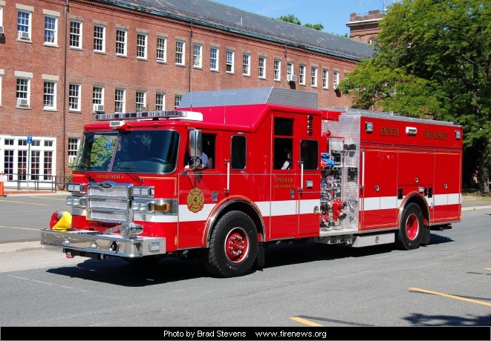
CURRENT ENGINE 14
2007 Pierce Lance Rescue Pumper
1250 GPM Pump
750 gal. tank
20 gal. Class A, 60 gal. AFFF Foam
11 foot -6000w Light Tower
30 kw Generator
Hydraulic Rescue system
GVW: 53,800

Slide 3

PROPOSED ENGINE 14
2029 Pierce Enforcer Rescue Pumper
Price of truck as currently specified is $1,241,689.00
1250 GPM Pump
750 gal. tank
30 gal. Class A Foam
Seats 6 FF
GVW: 46,463

Slide 4
Benefits / Differences
Modern Safety Features:
Passive systems like airbags and side roll protection.
Active systems such as collision avoidance, electronic stability control (ESC), and tire monitoring systems.
Innovative sound damping in the cab area to significantly reduce siren and road noise.
Modern / improved emergency warning lights.
Ergonomics:
Low Hosebed, and VERY low Crosslays
Added door-step for improved FF mounting and dismounting.

Slide 5
Benefits / Differences
No Built-in Generator, Light Tower or Hydraulic system.
Reduced Maintenance Costs.
Modern / improved suspension system – TAC 4.
Current Engine 14 should be “saleable” in the future.
Projected Lifespan – 25 years
The cost will be shared by future taxpayers who will also benefit from the apparatus.
As always, a well-defined funding strategy will be developed, if approved.

